Slide 1
Creative Production A1
Done by:
Keannu
Winston
Darius

Slide 2
Scenario
We have 6 months to produce a game for mobile devices for the Ministry of Education. The game’s goal is to teach Primary School students Science in a fun and engaging manner. The game will have a Physics Engine, 3D graphics, immersive audio and features attractive visuals to captivate the target demographic.

Slide 3
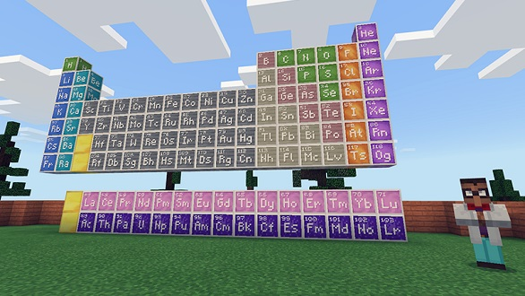
Minecraft Education Edition
Minecraft Education Edition is a version of minecraft where clients can purchase a licence to use the Game for $5 User/Year or through Volume Licensing which is much more flexible and affordable through the tailoring of the price.
Minecraft Education Edition teaches players many different topics such as chemistry, mathematics and coding.
We are using it as an inspiration as it is:
Easy to use
Different Topics can be taught
Engaging Learning Environment
Can be made in the Unity Engine
We are using a similar Physics Engine

Slide 4
Crew Breakdown
Project manager: facilitates team members and ensures proper scheduling of tasks to keep up with project deadlines.
Game Designer: Creates the concept of the game and the mechanics involved in the game.
Junior and Senior Developers: Develop the backend code for applications, ranging from mechanics to physics.
3D artists: Create the assets that will be used in the game, such as modelling, rigging, animating and character design.
QA Tester: Ensure that the game’s quality is satisfactory for publishing.
Sound Engineer: Produces immersive audio and sound effects for the game.

Slide 5
Job Listings
Numbers are taken from myskillsfuture.gov.sg and glassdoor.com:
Project Manager: 9k per month
Senior Developer: 7.5k per month
Junior Developer: 5k per month
Concept Designer: 5k per month
Sound Engineer: 3k per month
Junior 3D artist: 3.5k per month
Senior 3D Artist: 4.5k per month
QA Tester: 3.5k per month

Slide 6
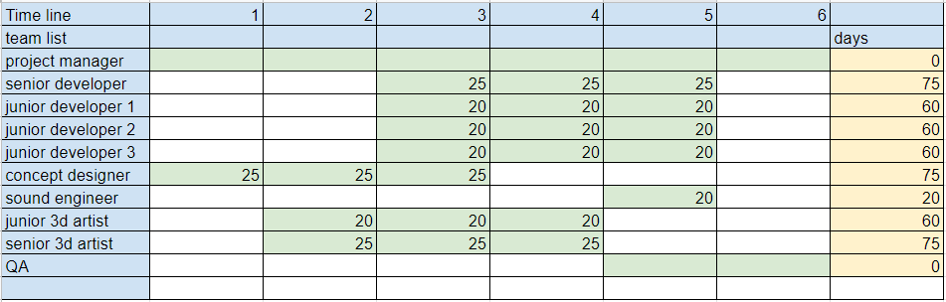
Man-days
Android 100 IOS 100 Backend 60 Game design 30
UIUX 40 Art 60 Sound 20

Slide 7
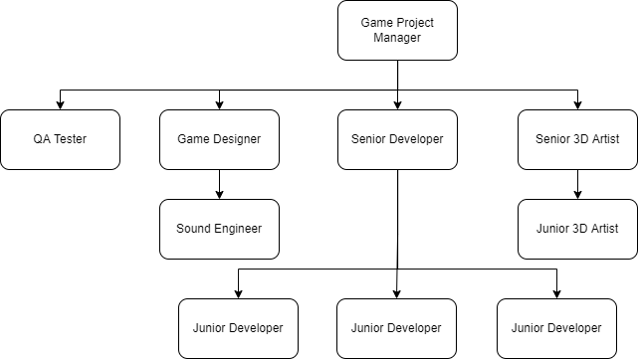








Our team set up

Slide 8
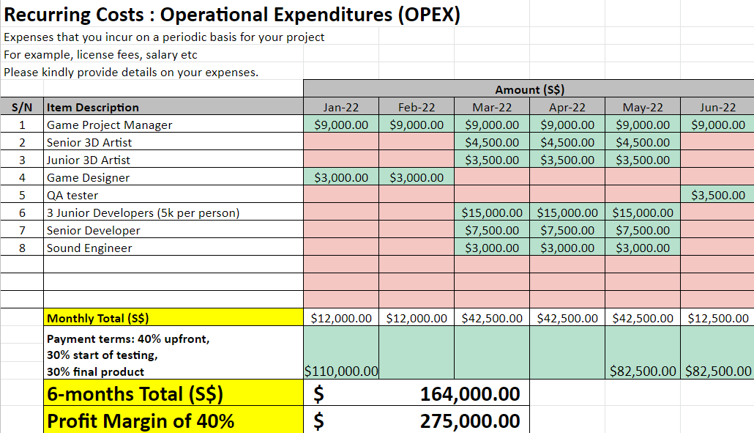
Timeline breakdown

Slide 9
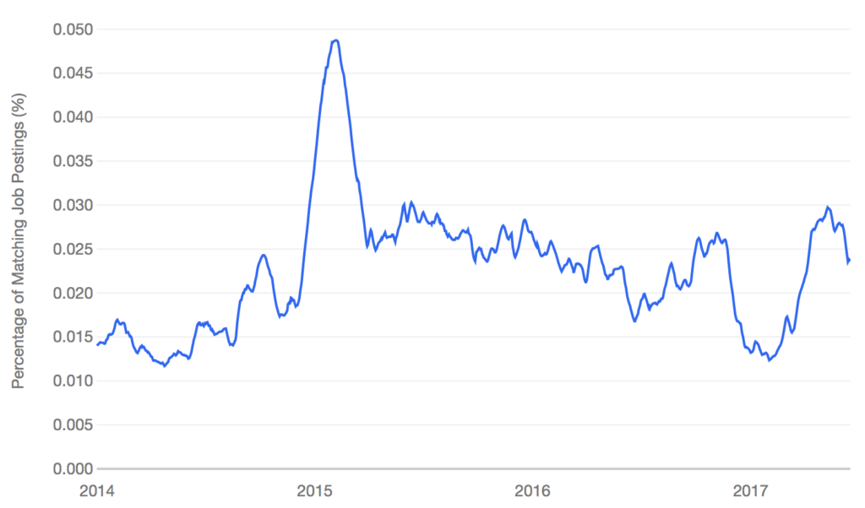
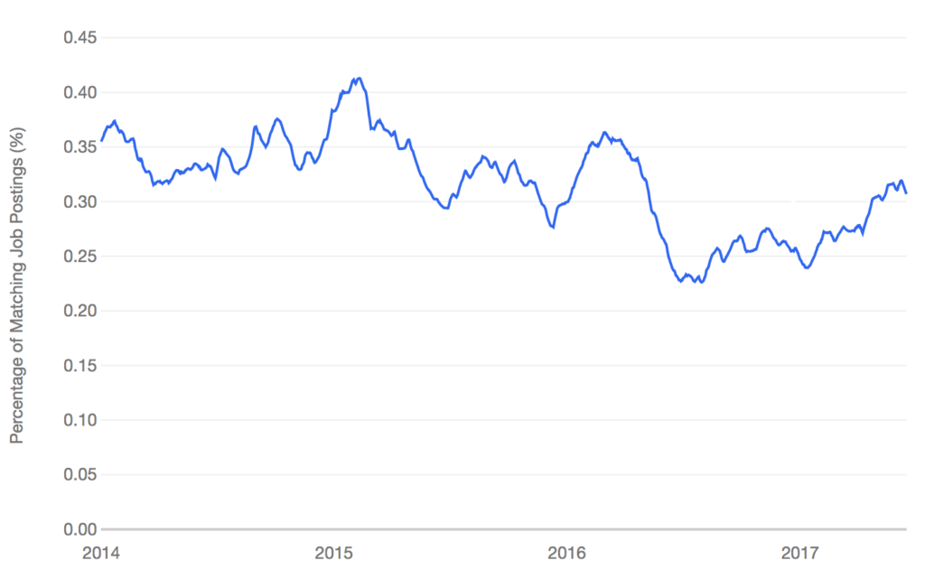
Market for Jobs
Demand has dropped from 2015 to 2017 so we’re able to find a freelance sound engineer with good qualifications at a lower rate.
Demand has been relatively stable when hiring a game designer so we are more likely to be able to find willing game designers.

Slide 10
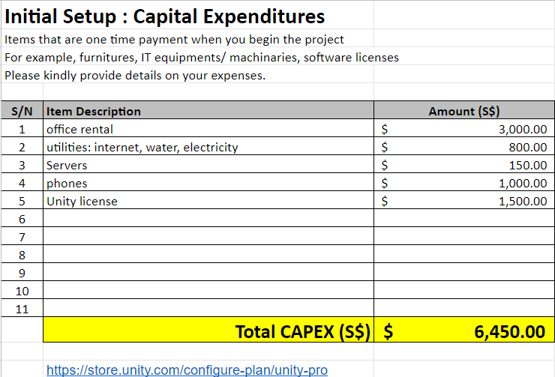
1 time payments-CAPEX
Office rental gives our employees a space to get work done
Average listings range from $400 to $1000, taken average is $500 monthly so in total $3000.
The average Utility bill in Singapore is $134 per month, averaging at $800 for 6 months.
Servers for us to share our work with a one-time purchase of $150
Phones for us to test the devices with a one-time purchase of $1000
Unity Licence which we must pay to publish the game under the Unity Engine with a one-time purchase of $1500

Slide 11
What if….
What if our employees fall ill?
We will find backups in case we are short on manpower. As immediate positions cannot be filled, progress will slow down, which means that the current members will have to work harder to compensate.
What if our game isn’t up to standard?
We will have longer time for testing and refinement, unfortunately running late. Thus implementing Agile’s Sprints to ensure that we have faster progress.
What if our employee’s equipment malfunction?
We will require the employee to use their own devices as possible, only providing equipment when necessary.

Slide 12
Task list
Winston | OPEX-50% | CAPEX-30% | Job listings, rental, job Demands | Equipment and Software licensing
Darius | OPEX-20% | CAPEX-40% | Team setup | Example Game Research
Keannu | OPEX-30% | CAPEX-30% | Job listings and rental | Trends

Slide 13
References, Links & Sources
Project manager: https://www.myskillsfuture.gov.sg/content/student/en/preu/world-of-work/occupation/occupation-detail.Project-Manager-15126.html
Sound Engineer: https://www.myskillsfuture.gov.sg/content/student/en/preu/world-of-work/occupation/occupation-detail.Sound-Editor-Sound-Engineer-123343.html
Senior 3D Artist: https://www.myskillsfuture.gov.sg/content/student/en/preu/world-of-work/occupation/occupation-detail.Senior-3D-Artist-(Modelling-Rigging-Texturing,-Digital-Lighting,-Digital-Compositing)-123444.html
Quality Assurance Tester: https://www.myskillsfuture.gov.sg/content/student/en/preu/world-of-work/occupation/occupation-detail.Quality-Assurance-Tester-123442.html
Software Engineer: https://www.myskillsfuture.gov.sg/content/student/en/preu/world-of-work/occupation/occupation-detail.Software-and-Applications-Developer-79348.html
Game budget:: https://imaginovation.net/blog/mobile-game-app-development-cost/#:~:text=As%20the%20cost%20involved%20in,a%20high%2Dend%20mobile%20game
Job demand for sound engineer: https://www.gameindustrycareerguide.com/video-game-audio-engineer-salary/
Job demand for game designer: https://www.gameindustrycareerguide.com/video-game-designer-salary/

